Slide 1

Exploratory Data Analysis on AMEO Dataset
Shirisha Chintalapudi

Slide 2
Problem Statement
To determine how salary is influenced by factors such as marks, educational qualifications, experience, and designation, enabling students to choose their career paths wisely based on skills, education, and other relevant factors.
Objective
Analyze the target variable 'salary' and find insights from it

Slide 3
Description:
The dataset, sourced from the Aspiring Mind Employment Outcome 2015 study, focuses on employment outcomes of engineering graduates. It includes variables like salary, job titles, and locations, alongside standardized scores in cognitive, technical, and personality skills, and demographic features. With around 4000 data points, it provides insights into the factors influencing graduates' professional paths

Slide 4
Data Cleaning and Data Manipulation
Dropping College ID and college city, ID etc
• Dropping columns which are unnecessary or may not be known prior
to receiving a job offer.
• Changing the data type as required.

Slide 5
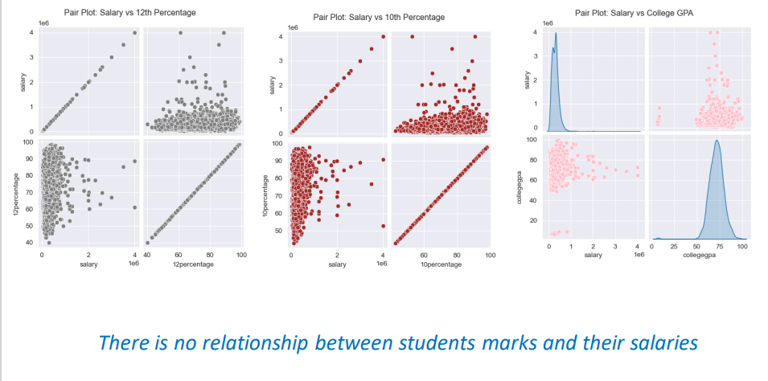
Insights :

Slide 6
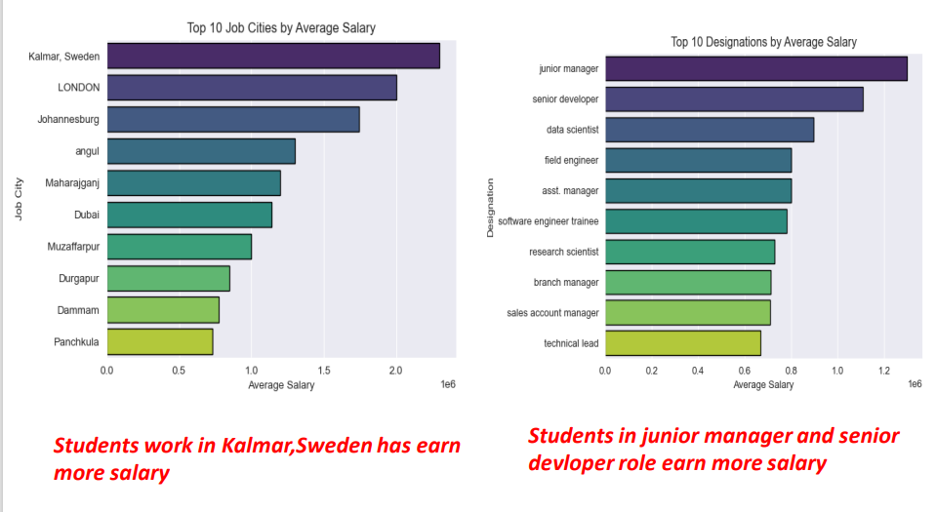

Slide 7
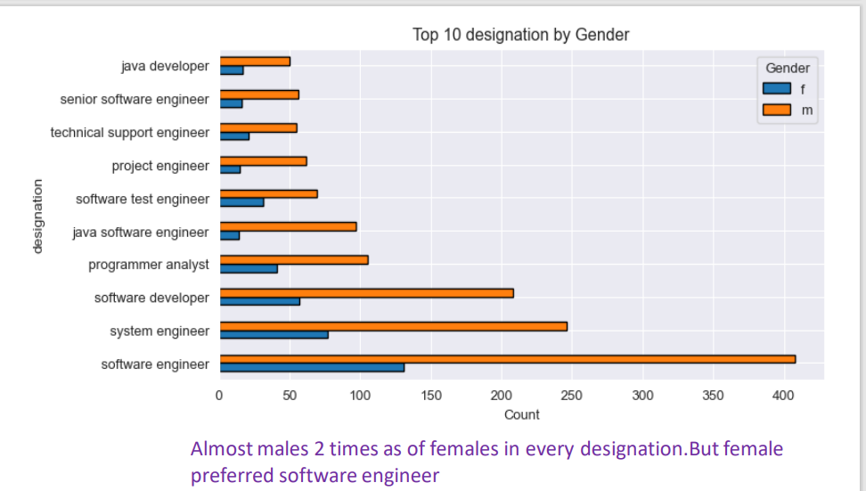

Slide 8
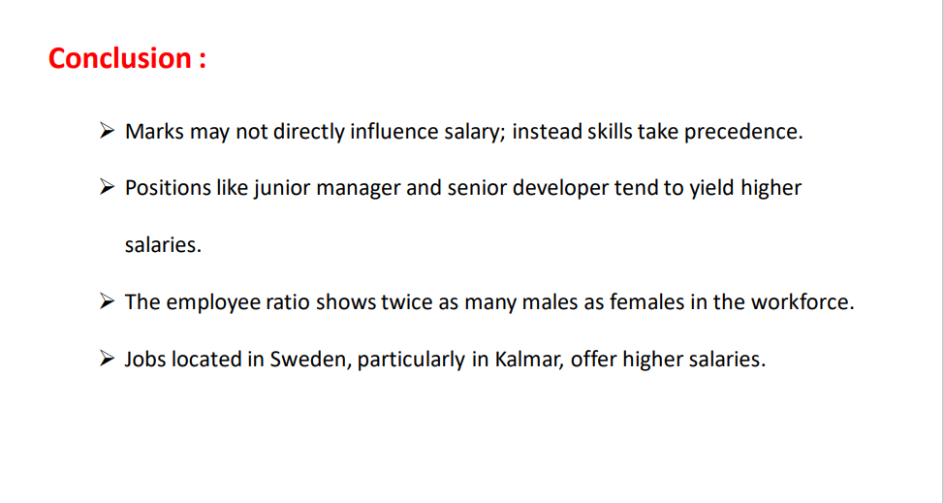

Slide 9

THANK YOU

